Slide 1

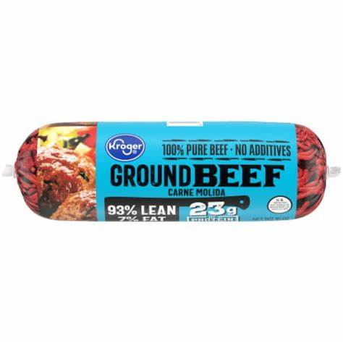
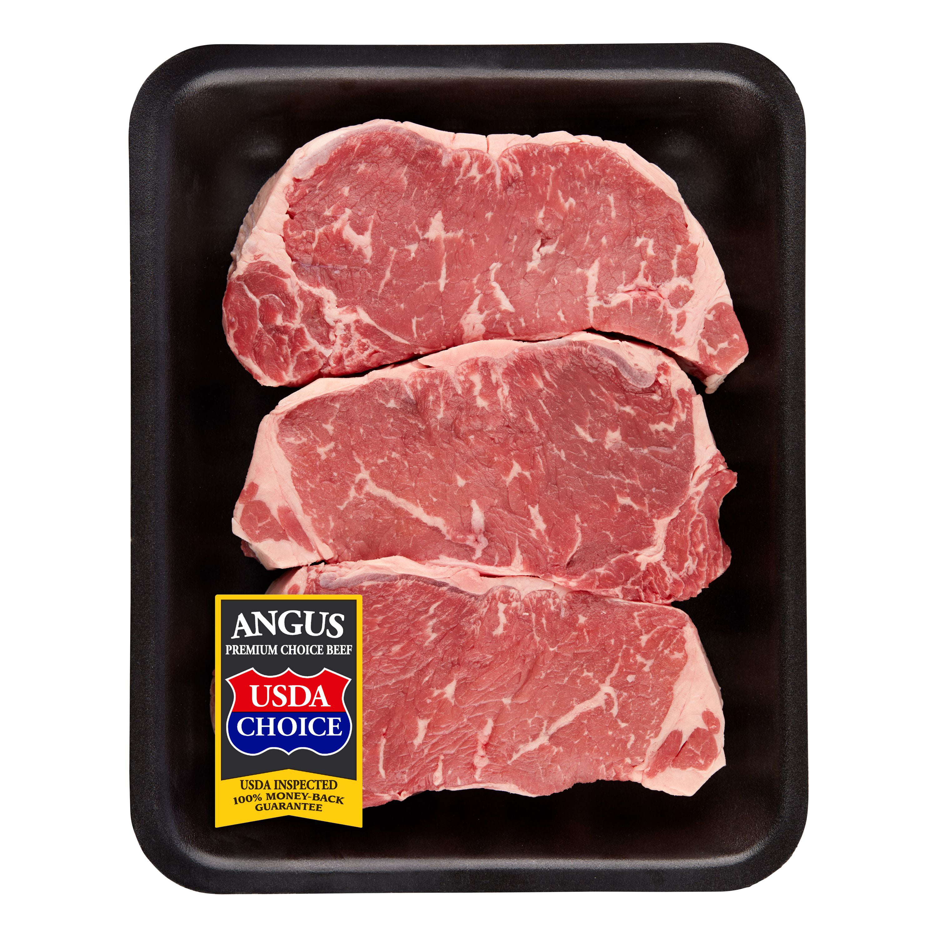


ACDS TRANSACTIONS SAMPLE DATA OVERVIEW
ITEM DESCRIPTION | PERDUE FRESH WHOLE CHICKEN WINGS | KROGER 1 LB GROUND BEEF 80/20 | CHOICE STRIP STEAK FAMILY PACK | ORGANIC BANANA | APPLE FUJI LARGE
GTIN | 00250810000008 | 00011110969729 | 00202227000003 | 00000000940115 | 00000000041317
PACKAGING | PREPACKAGED | PREPACKAGED | PREPACKAGED | LOOSE | LOOSE
SOLD BY UOM | POUNDS | EACH | POUNDS | POUNDS | POUNDS
TYPICAL TRANSACTED UOM UNITS | 1.91 | 1 | 2.73 | 2.23 | 1.72
TYPICAL BASE RETAIL PRICE PER UNIT | $4.99 | $5.99 | $13.99 | $0.69 | $1.79
IS SOLD WEIGHT RECORDED? | YES | YES | YES | YES | YES

Slide 2
GTIN – 250810000008 PERDUE® Fresh Whole Chicken Wings [PMY DPT(09) – MEAT]
Transaction period – 2022/01/01 to 2023/09/24
Mode of Pickup
Delivery
Promo
applicable
Store Inventory
Instore
Sold in weights
- Prepacked
(Pounds)
Can be sold in random weight
Net amount spent =
Retail $ amt – Discount – Markdowns -coupons
Display
Flyer
Pickup
Net sales $ amount is a parameter of coupons, discounts, markdown, promotion, targeted campaigns etc.,

Slide 3
GTIN – 202227000003 Choice Strip Steak Family Pack [PMY DPT(09) – MEAT]
Transaction period – 2022/01/11 to 2022/12/27
Mode of Pickup
Instore
Promo
applicable
Store Inventory
Sold in weights
- Prepacked
(Pounds)
Can be sold in random weight
Display
Flyer
Digital
Net amount spent =
Retail $ amt – Discount – Markdowns -coupons
Pickup
Net sales $ amount is a parameter of coupons, discounts, markdown, promotion, targeted campaigns etc.,

Slide 4
GTIN – 11110969729 Kroger® 1 lb. Lean Ground Beef Chuck 80/20 [PMY DPT(09) – MEAT]
Transaction period – 2022/01/01 to 2023/09/24
Mode of Pickup
Delivery
Promo
applicable
Store Inventory
Instore
Sold in weights
- Prepacked
(Pounds)
Sold in 1 LB
Net amount spent =
Retail $ amt – Discount – Markdowns -coupons
Display
Flyer
Pickup
Net sales $ amount is a parameter of coupons, discounts, markdown, promotion, targeted campaigns etc.,

Slide 5
Questions
What are the different units of measurement in which the items are sold in Kroger
What is the average unit price for each UOM for the last 2 years
Data on the following for each item if applicable
Discount
Coupons
Markdown
Targeted campaign
Inventory data for each item by store by week/day

Slide 6
GTIN – 250810000008 PERDUE® Fresh Whole Chicken Wings [PMY DPT(09) – MEAT]
 | Observations | Comments
1. | Base retail Price is available from the data shared for all transactions. Can this be considered to be correct? | If the assumption is correct, discount and other variables in price can be neglected
2. | GTIN_UOM_AM is the weight of item | Is the assumption correct?
3. | Wt_Fl is the indicator to identify whether the item is sold in weight or each | Is the assumption correct?
4. | Scn_unt_qy is the number of units scanned in transaction | Is the assumption correct?
5. | If the rtl_dol_am and net_spend_amt is same then there is no promotion or discount provided | Is the assumption correct?

